Slide 1

Online Examination System
Education: Opening Your Mind

Slide 2

01
02
03
DASHBOARD
COURSE
EXAM
TABLE OF CONTENTS
04
05
06
RANKING
REPORT
FEEDBACKS
You can log in as admin and see the dashboard displayed on the screen.
You can choose any available course.
It will help students to study and conducting test of the particular course.
When the candidates submit the exam , they can view the ranking list.
This system helps students to take examination online.
Something about our Examination system.

Slide 3

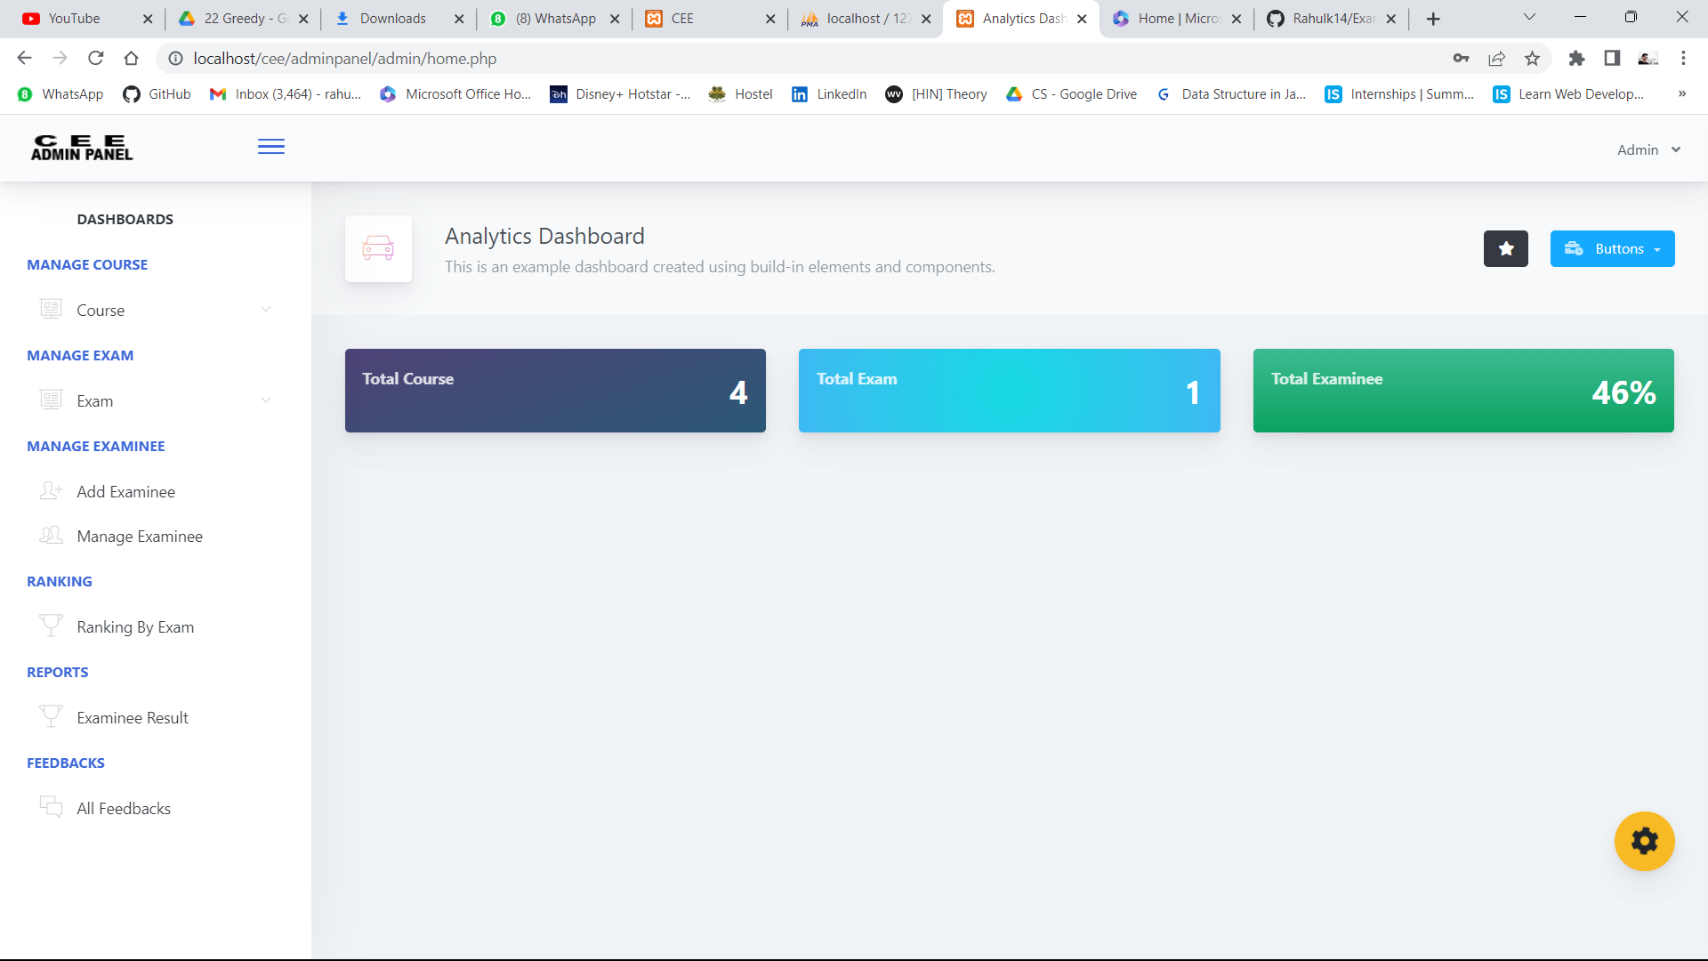
MISSION STATEMENT
We created this website it offers a reliable efficient and cost effective solution for conducting online exam and save the time.

Slide 4
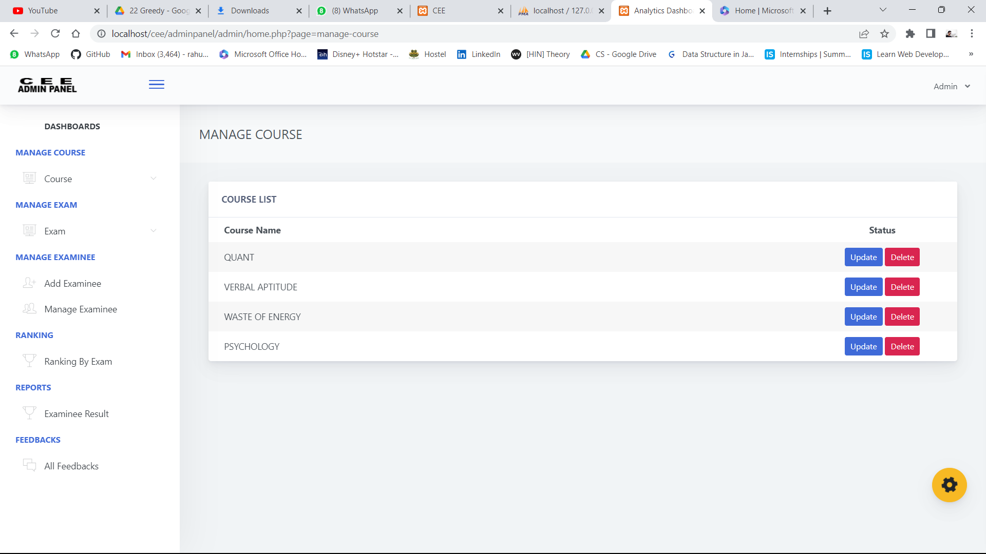
COURSES

Slide 5

Online Examination System
Welcome to our Online Examination System, the innovative web application designed to provide a seamless and hassle-free experience for conducting online exams. With the increasing need for remote and ﬂexible learning, our platform offers a convenient solution for educational institutions, corporations, and individuals to create, administer, and manage online exams.

Slide 6

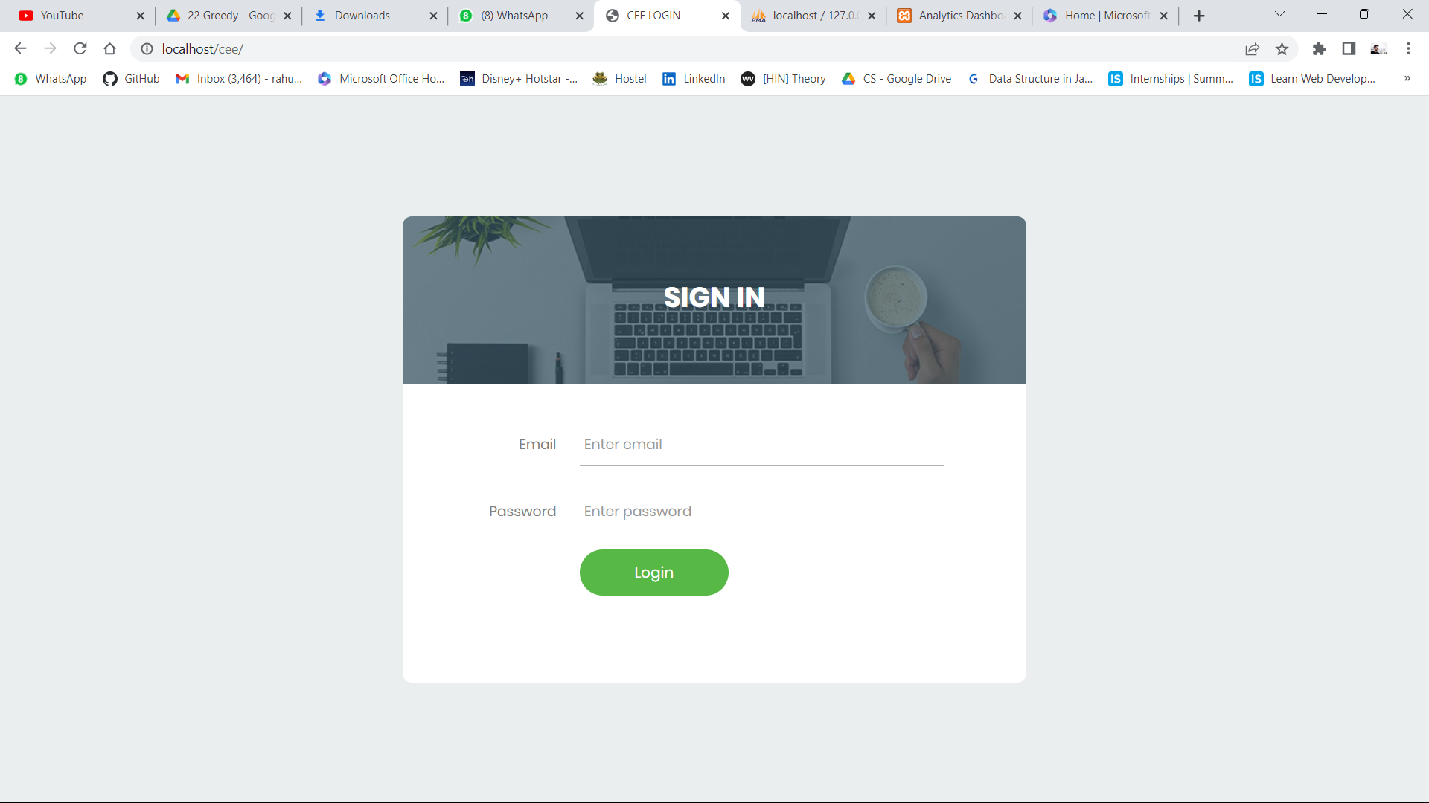

Slide 8
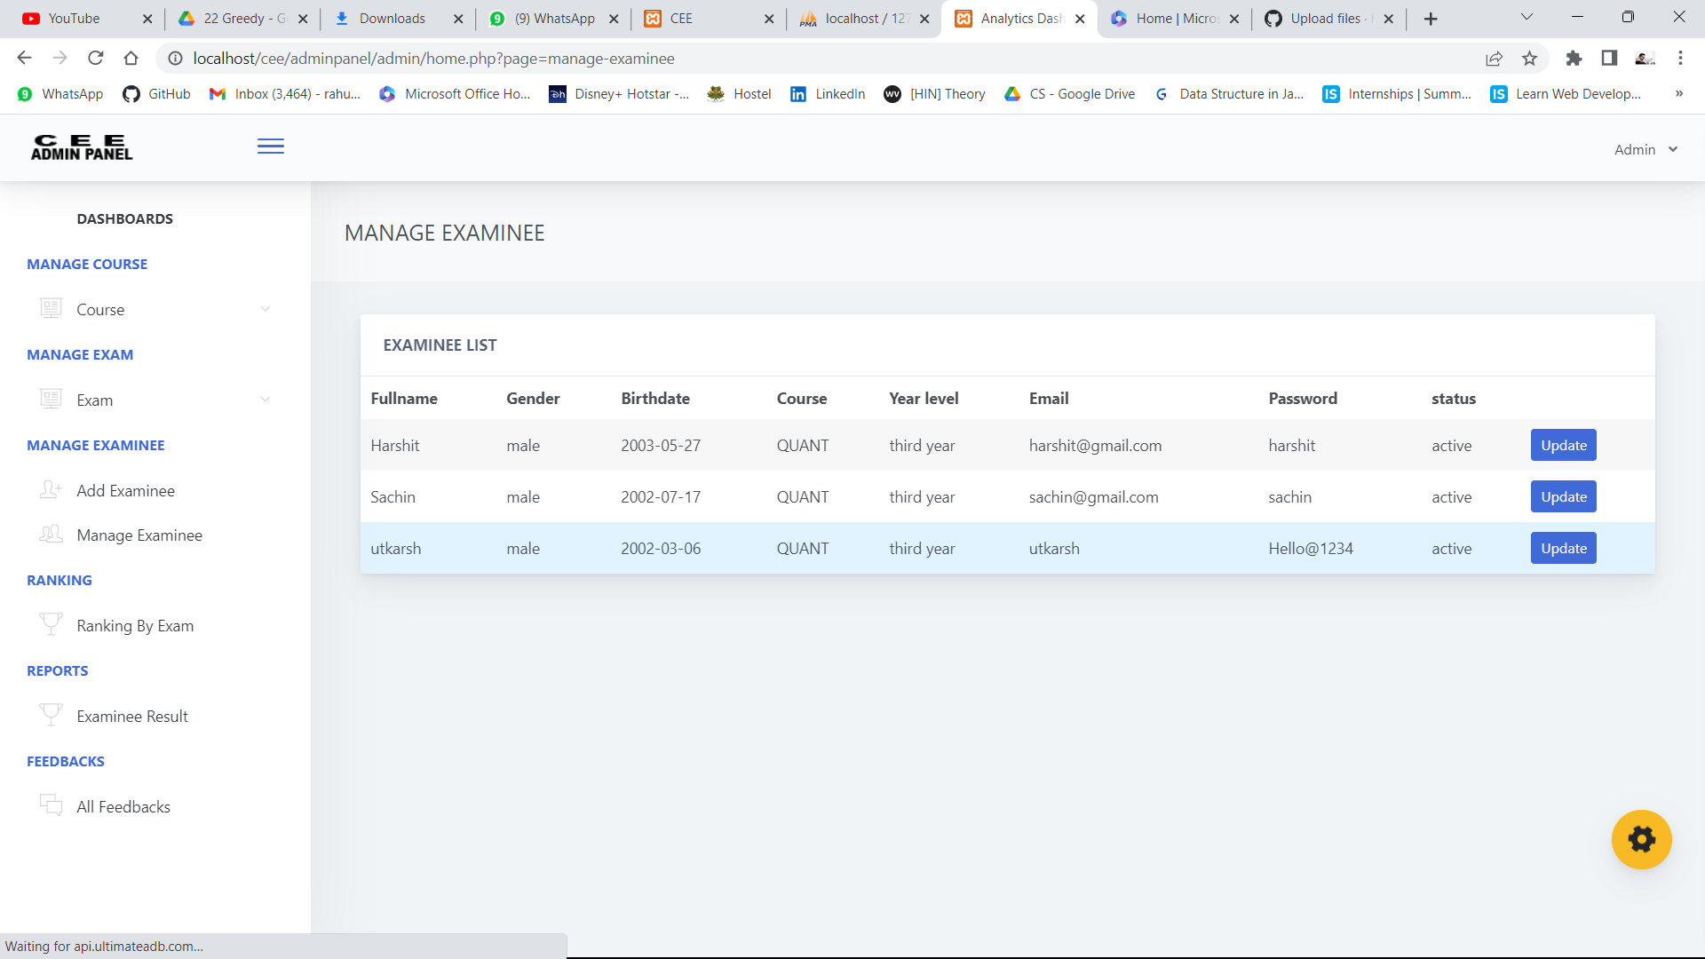

Slide 9
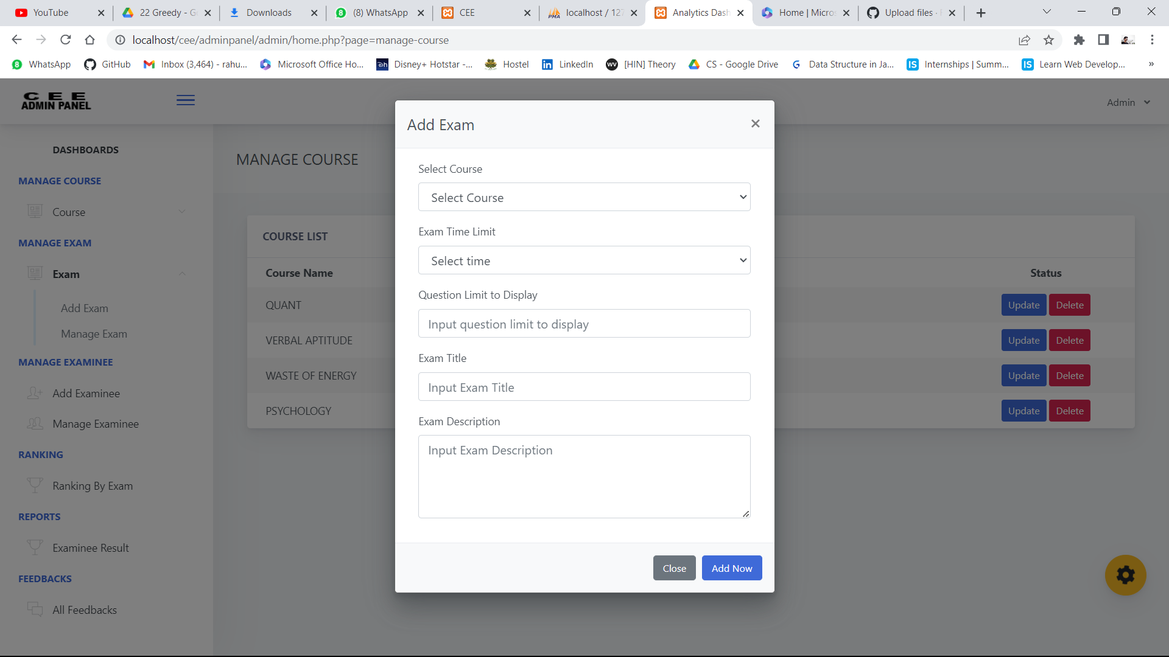
Add Exam

Slide 10
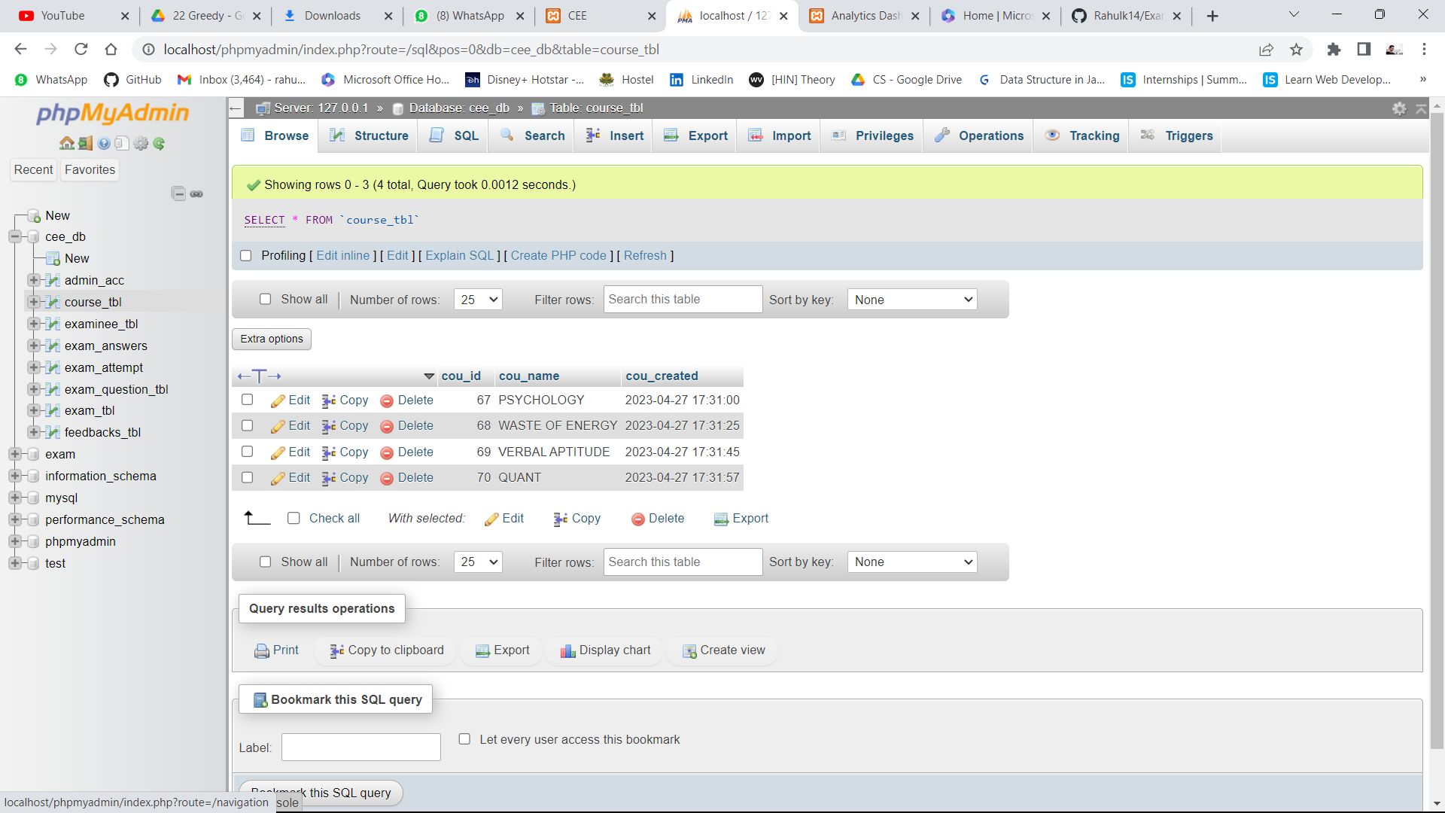
Database

Slide 11

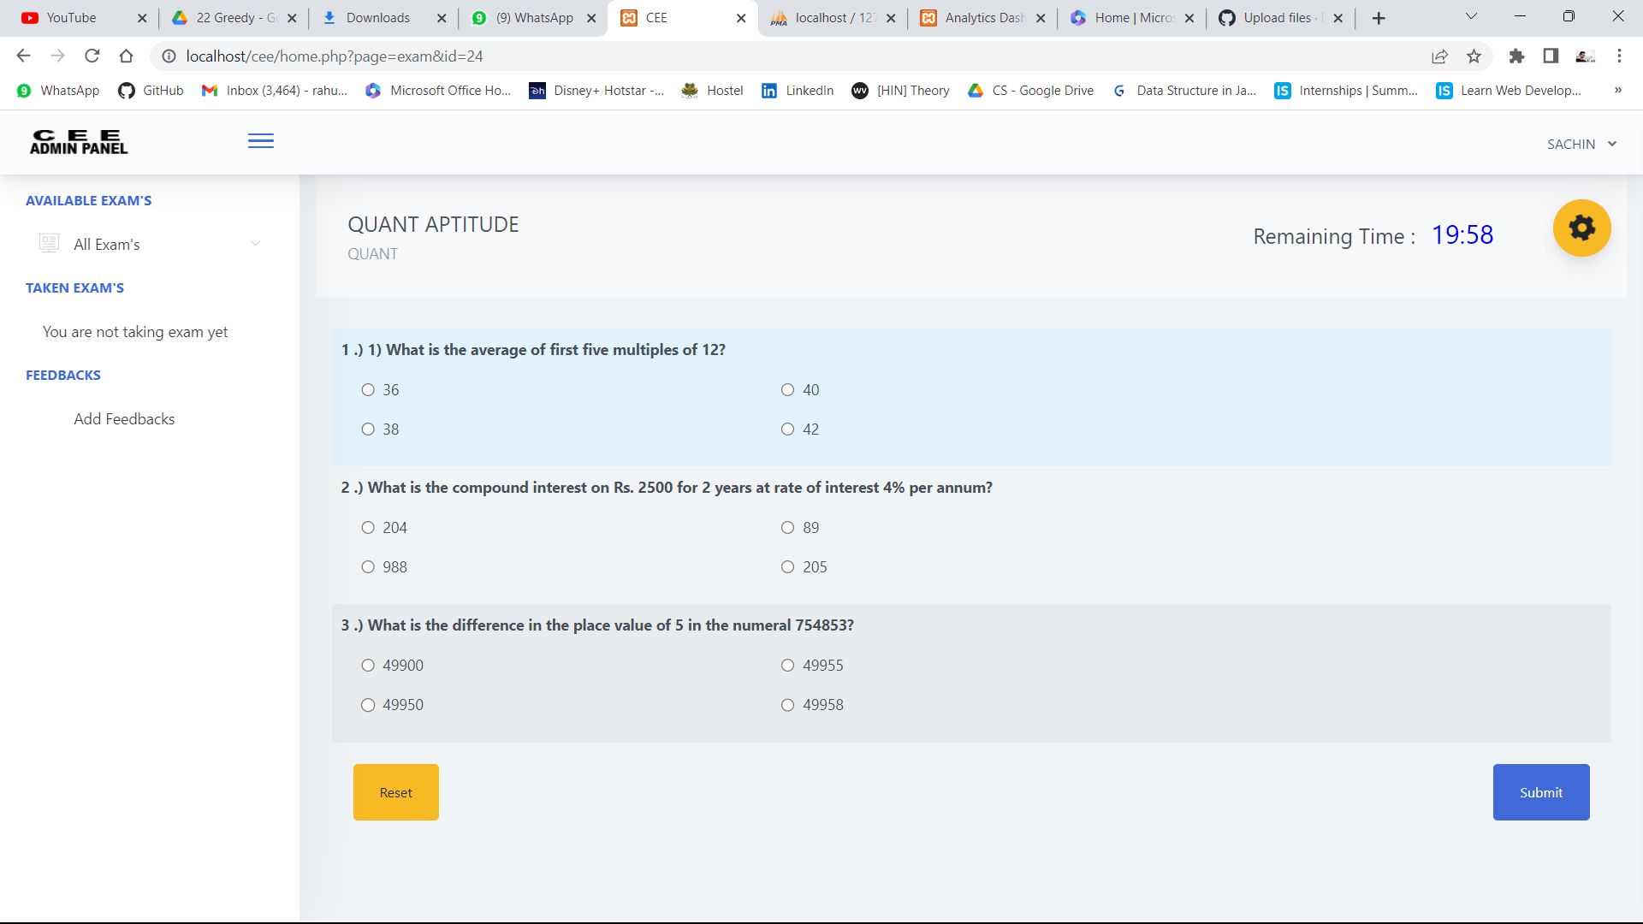
Live Exam Portal
60
10
20

Slide 12
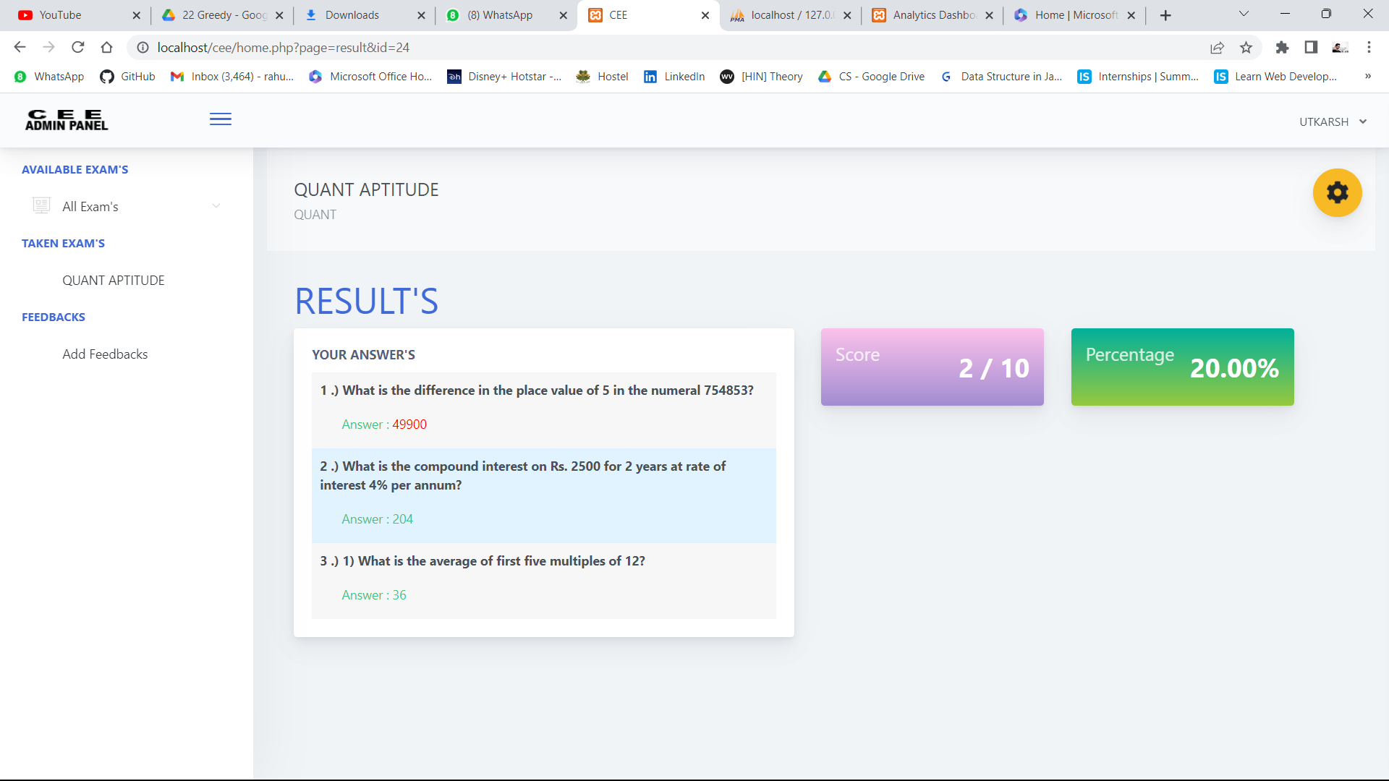
Exam Result’s
Don’t Give up : You Are Almost there.

Slide 13
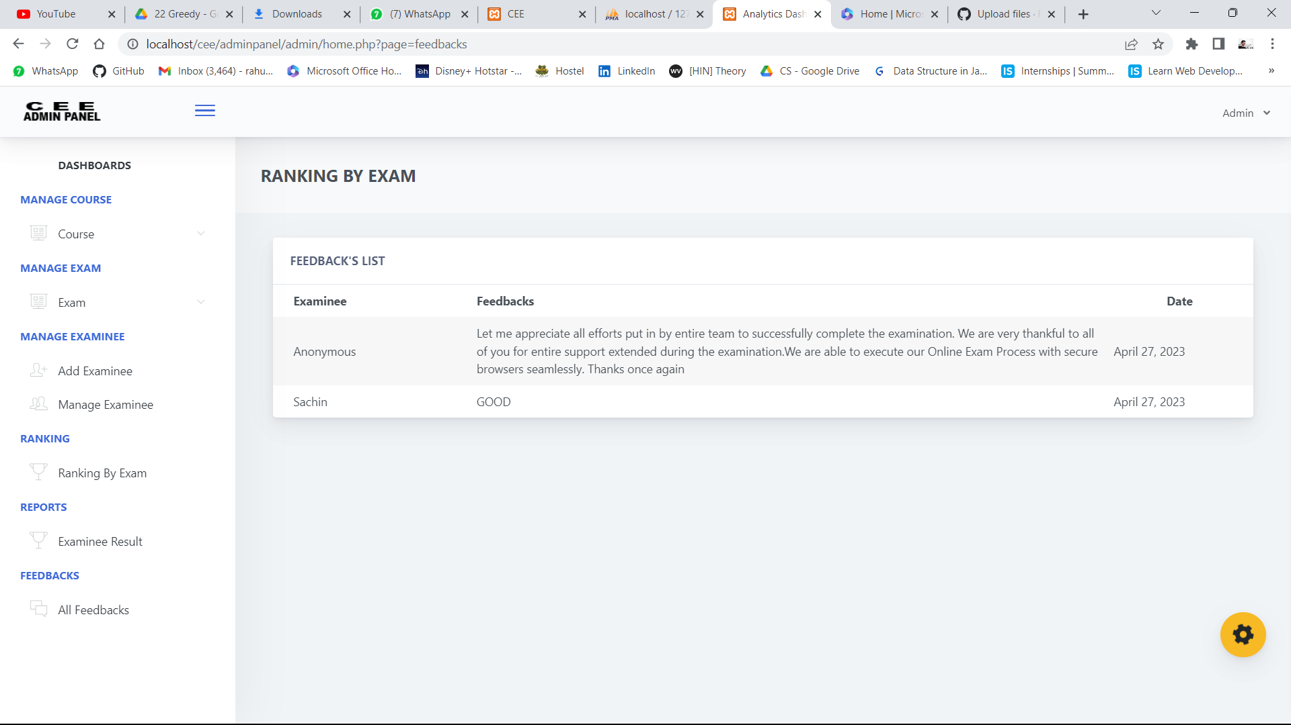
Feedback’s List

Slide 14

THANK YOU

